Slide 1

CARGURUS.COM
Selenium automation TESTing PRESENTATION

Slide 3
INTRODUCTION
This project is about an actual process of Functional and Manual testing. Using the Selenium Automation Testing tools and techniques we can detect the mistakes made by development team. Those tools helps to catch a bug before product is released.
Management of this Project faces various processes: handling logic thinking, communications, risk and challenges, time management.

Slide 4
OVERVIEW OF THE CarGurus
CarGurus is a global, online automotive marketplace connecting buyers and sellers of new and used cars and third party administration.
Using proprietary technology, search algorithms, and innovative data analytics, CarGurus provides unbiased insights on car pricing, dealer reputation, and vehicle history.
For used vehicles calculates a fair retail price based on a detailed analysis of comparable current and previous car listings in a given market

Slide 5
Data exchange system:
Consumers
Employees
Third Party Administration
Dealers
Private Sellers

Slide 6
Website Modules:
Main Menu:
- Used cars
- New cars
- Car Values
- Sell my car
- Research
- Questions
- Advertisement
- Language & Country (changer)
Login Menu:
Saved Searches
Saved listings
Financing
Inbox
Sing In
Home Page:
Search Engine Module
Additional Text Info
Review Block
Recent Test Drives Info
Recent Preview Module
Popular Makers
Certified Pre-Owned Block
Popular New Cars Info Block
Popular SUV’s/Crossovers Info Block
Popular Sedan Cars Info Block
Popular Pickup/Trucks Info Block
Popular Wagon Cars Info Block
Popular Coupe Cars Info Block
Popular Minivan Cars Info Block
Popular Hatchbacks Cars Info Block
Footer Menu:
Company:
About Car Gurus
Our Team
Press
Investor Relations
Price Trends
Mobile
Blog
Careers
For Dealers:
Dealer Signup
Dealer Resources
Terms:
Terms of Use
Privacy
Interest Based Ads
Help:
Help
Contact Us
Language filter
Country filter
Copyright info

Slide 7
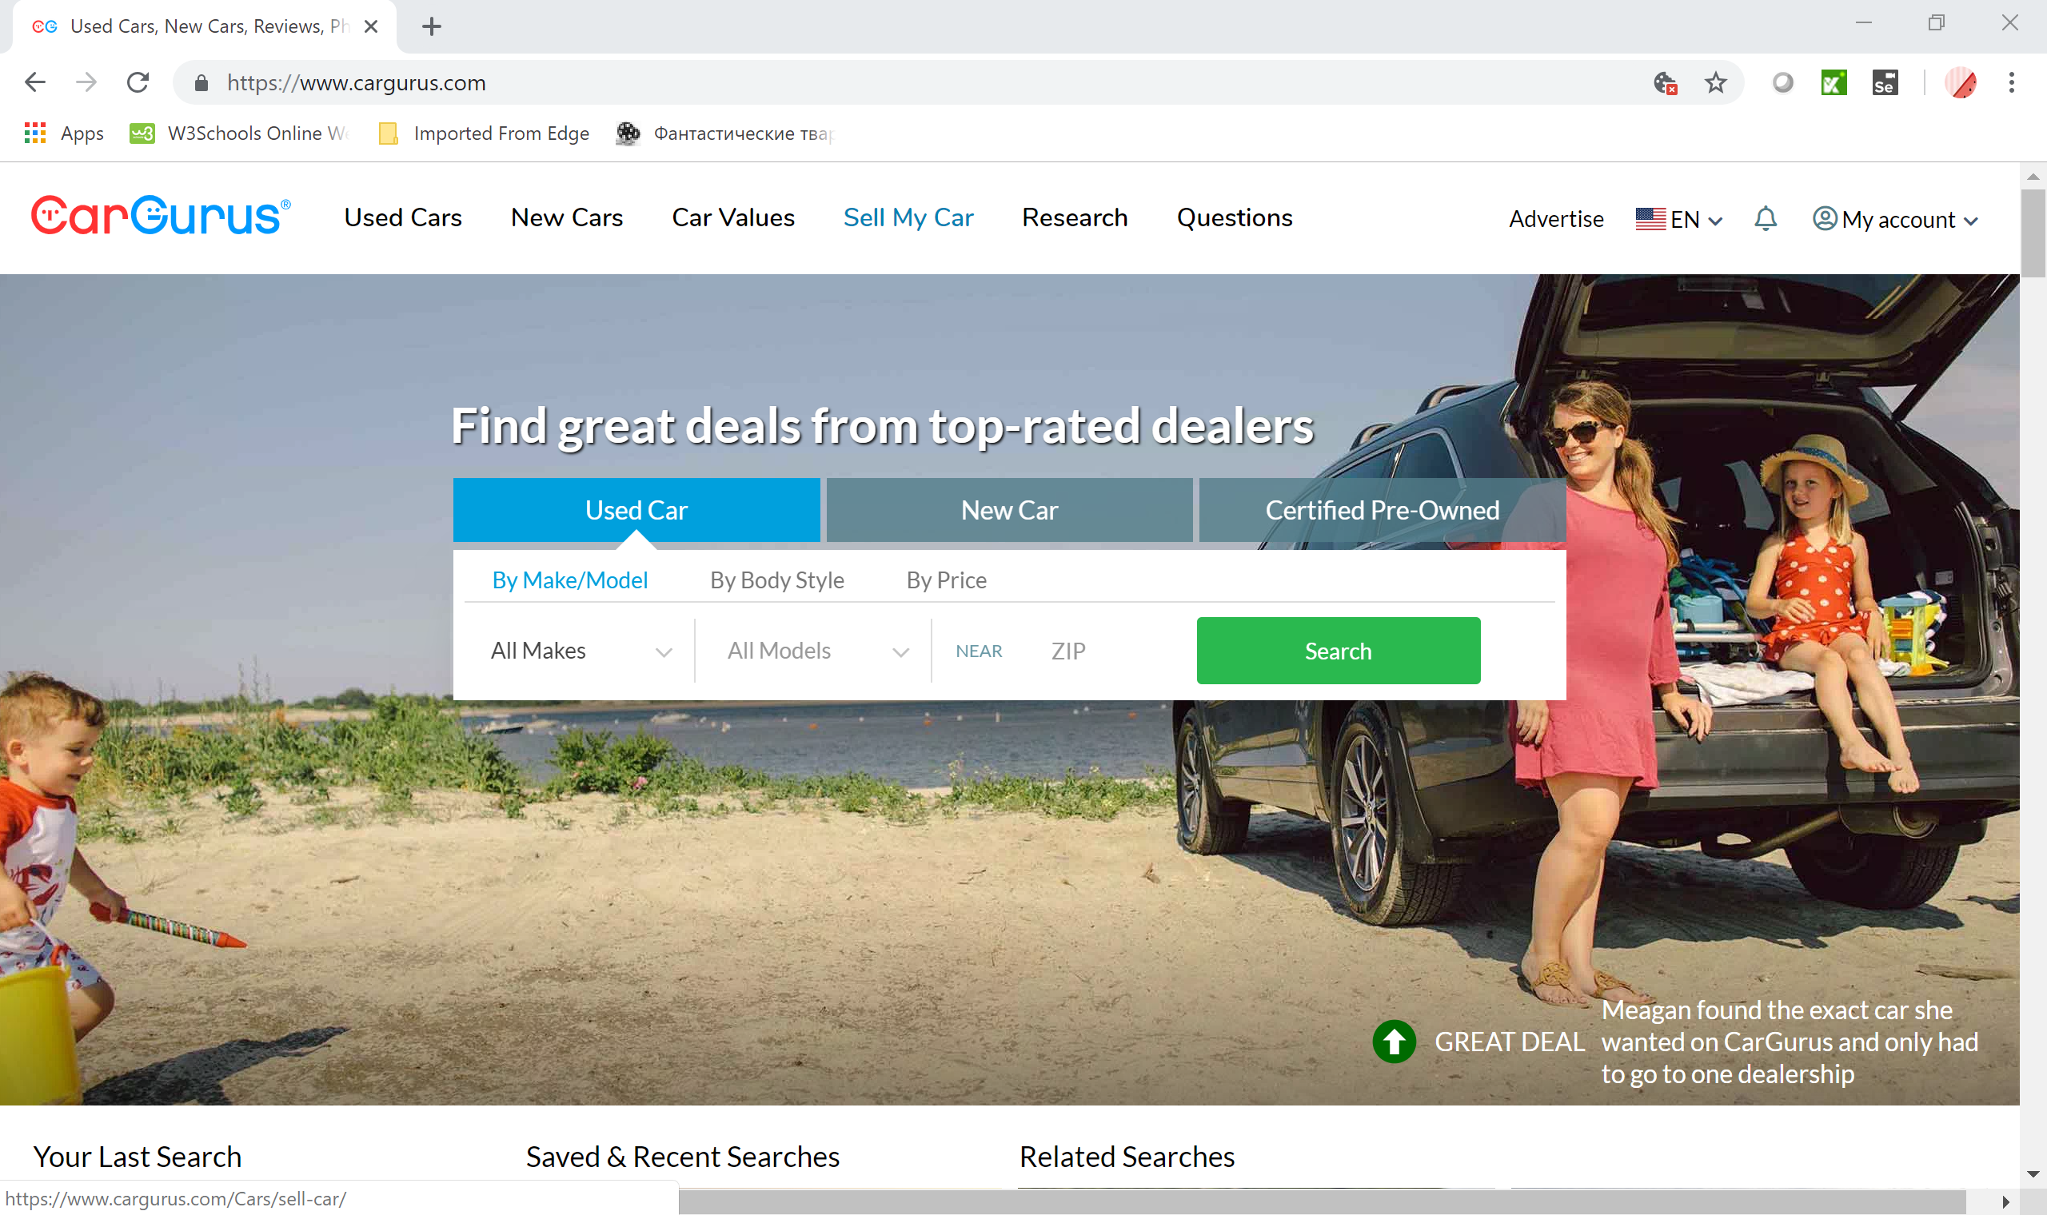
Website interface
Website has a home page with select boxes for used cars, new cars and certified Pre-owned.
This page has the option for login and password for registered users. For new customers has clickable link and helpline in order to create a new account or sign up using existing Facebook or google account.

Slide 8
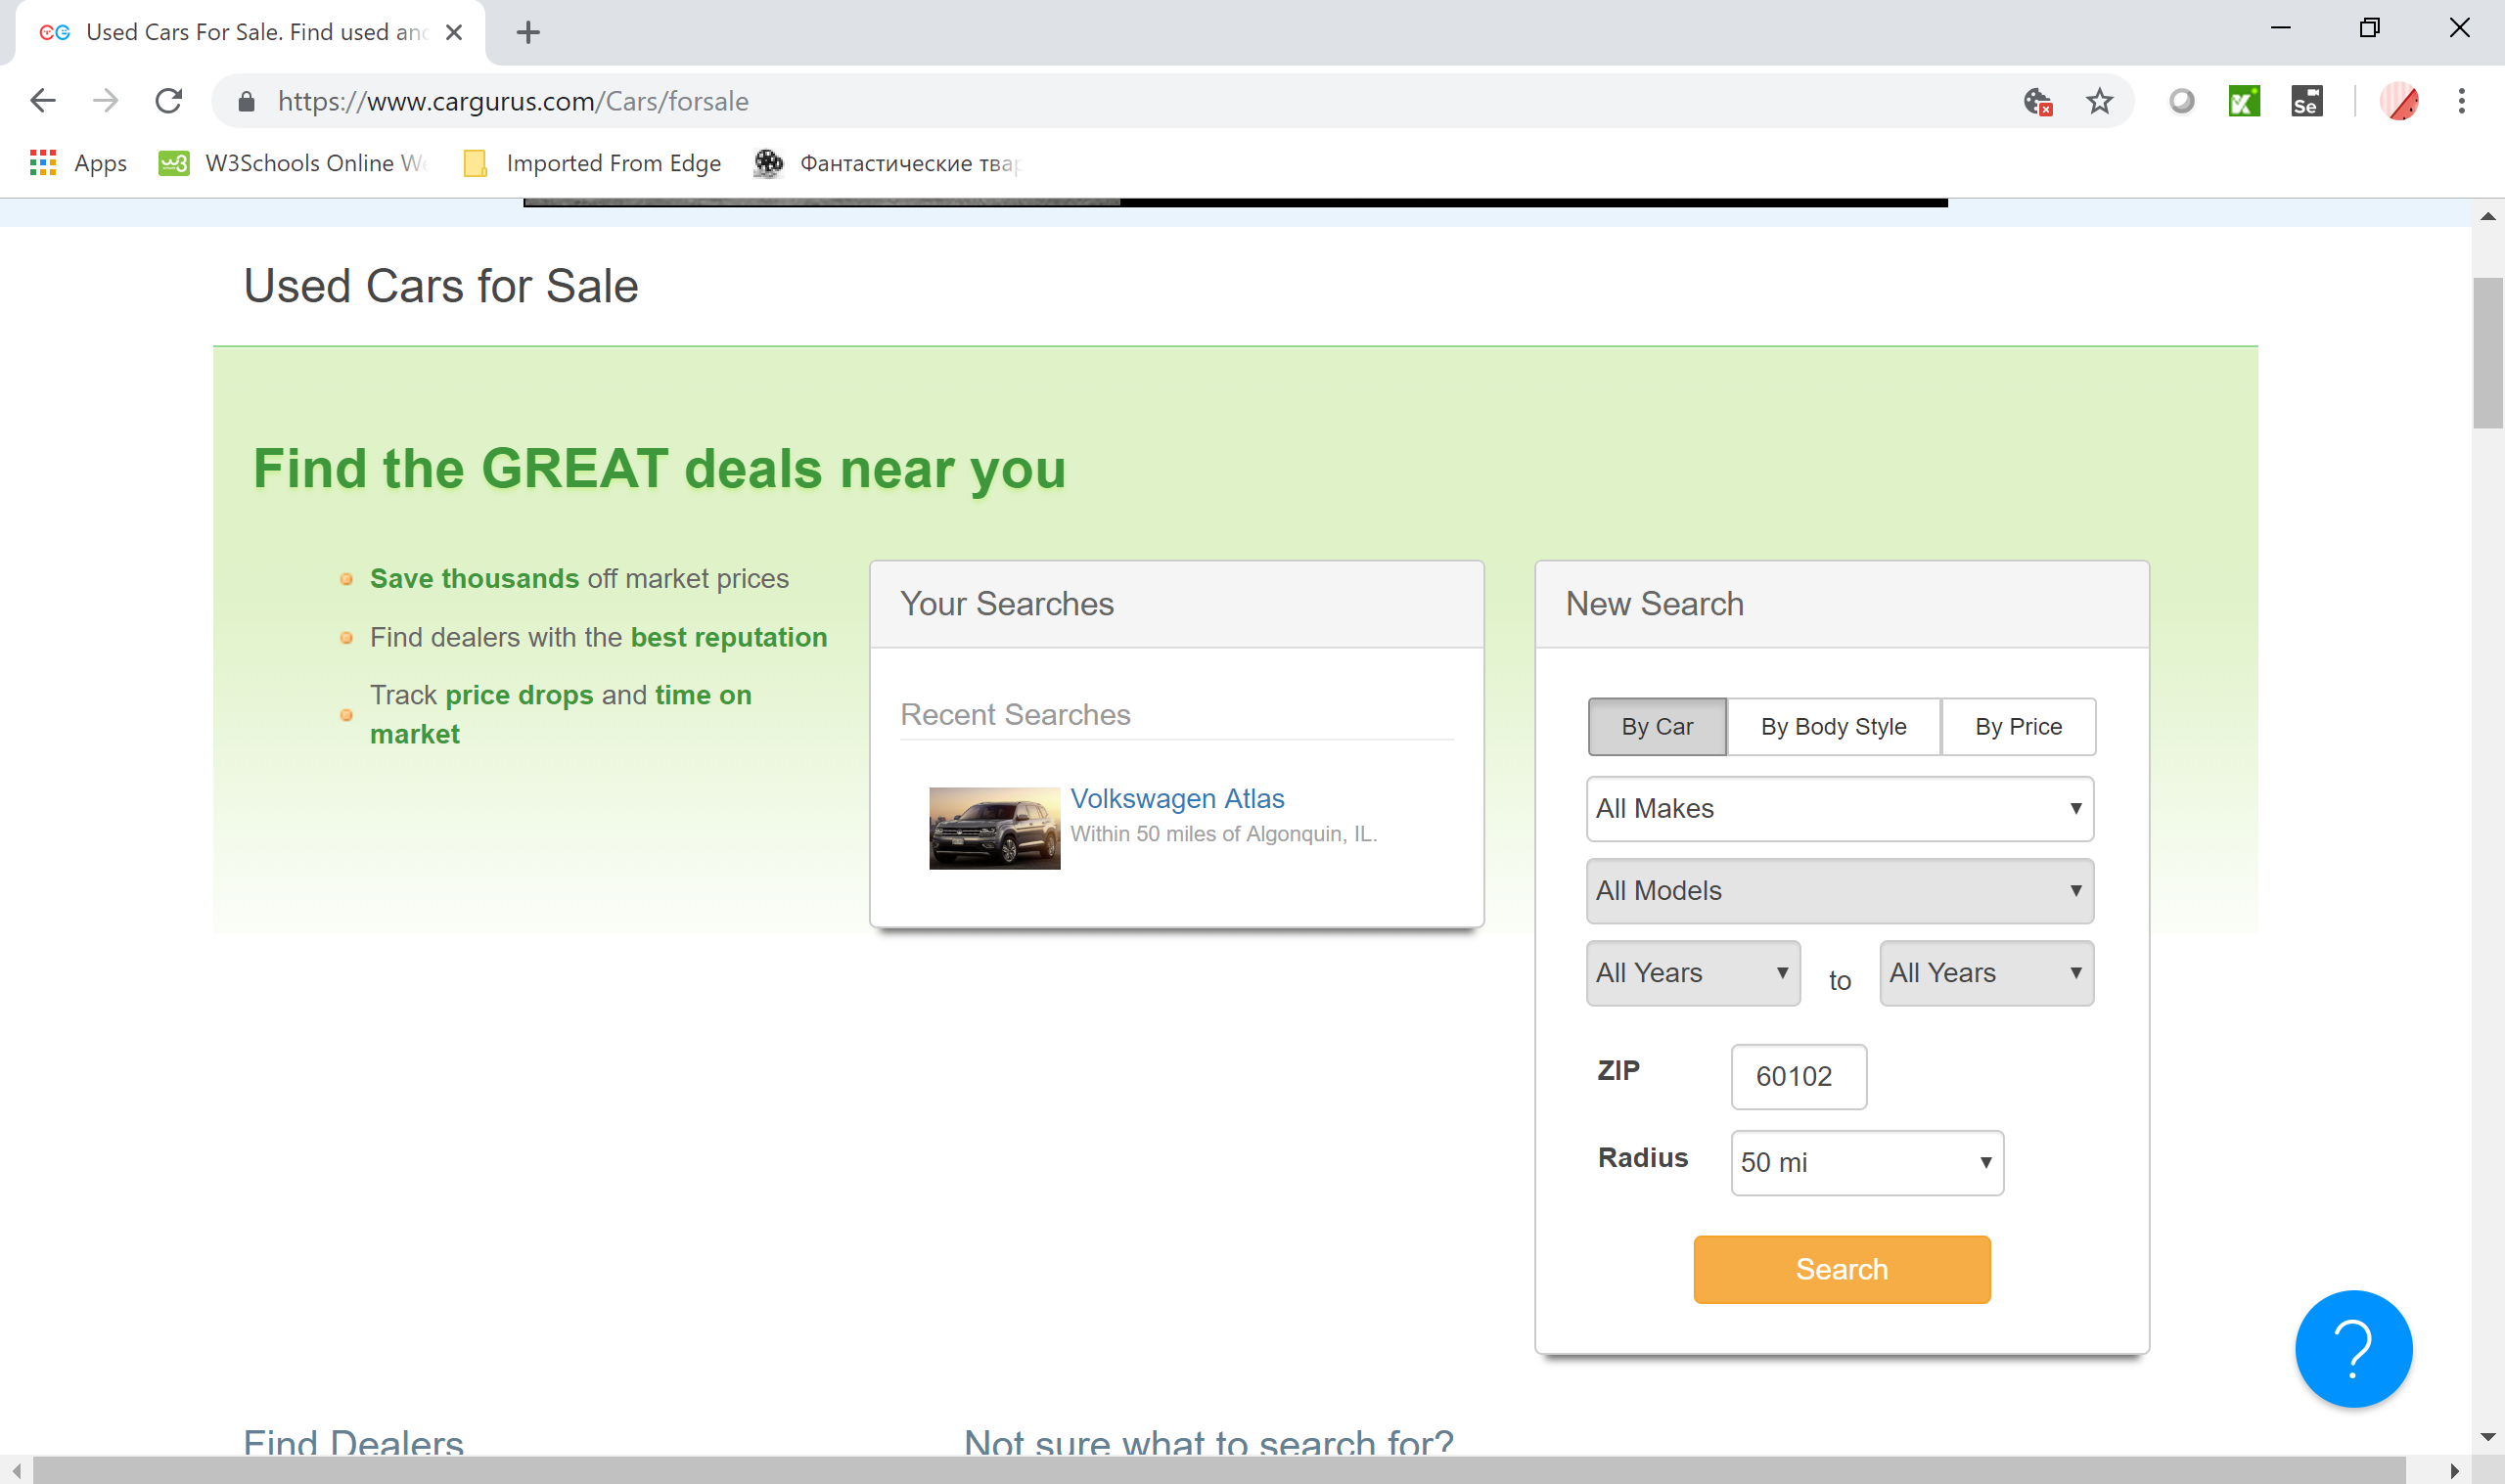
USED CARS FOR SALE SEARCH ENGINE

Slide 9
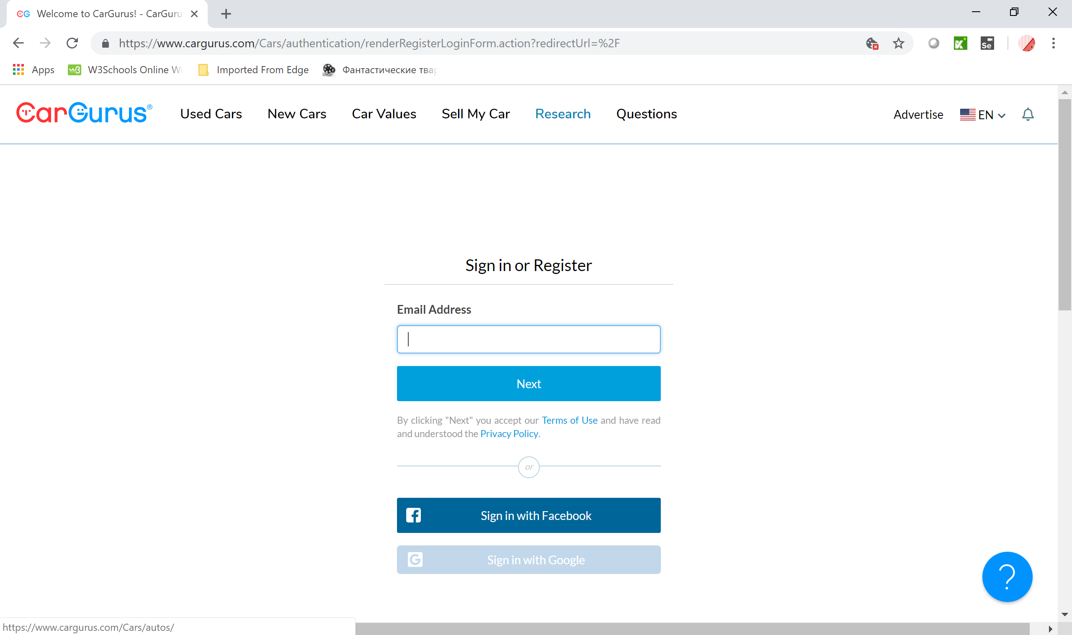
SIGN IN OR REGISTER PAGE

Slide 10
TEST PLAN
Introduction
SCOPE
Features To Be Tested
Features Not To Be Tested
ENTRY/EXIT CRITERIA
TEST APPROACH
Pass / Fail Criteria
Testing Process
RISK AND ASSUMPTIONS

Slide 11
TEST PLAN Introduction
Software testing is a critical element of software quality assurance and represents the ultimate review of specification, design, and coding. Test Automation is the best way to increase the effectiveness, efficiency and coverage of our software testing.
Test objectives are to provide adequate coverage metrics and requirements validation to verify that the functionality of CARGURUS works as expected.
Test SCOPE - testing CARGURUS for its functionality to ensure proper application navigation, data entry, processing, and retrieval.

Slide 12
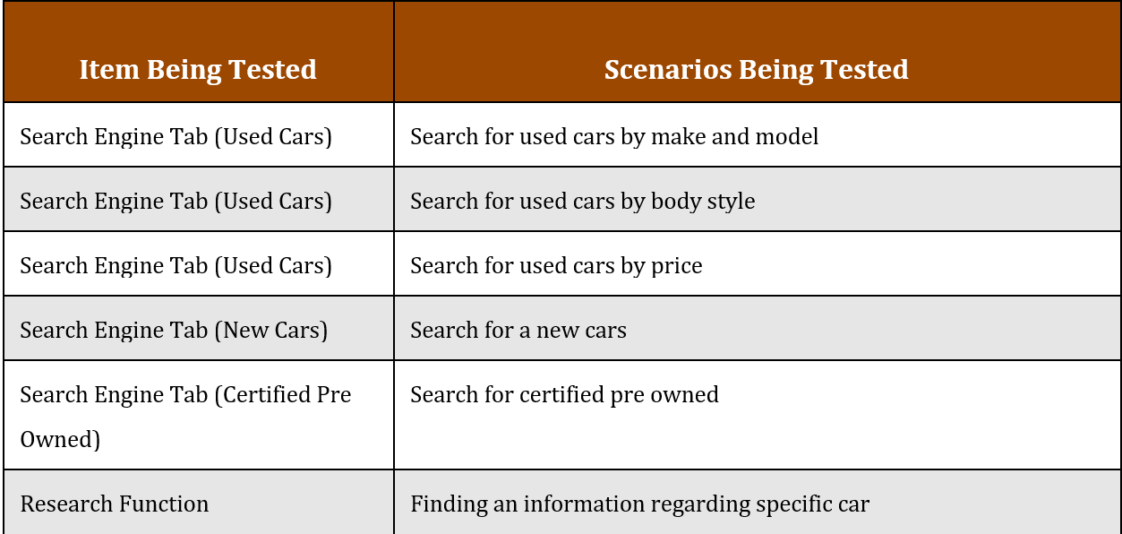
Features To Be Tested

Slide 13
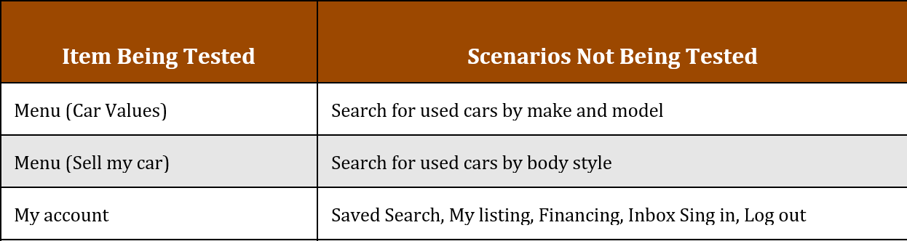
Features Not To Be Tested

Slide 14
Entry and Exit criteria:
Entry criteria:
Complete or partially testable code is available.
SUT is defined and approved.
Availability of sufficient and desired test data.
Test environment has been set-up and all other necessary resources such as tools and devices are available.
Test Plan, Test Cases and Test Data are developed and written.
Exit criteria:
Deadline is met.
Execution of all test cases.
Achieving complete Functional Coverage.
No high priority or severity or critical bug has been left out.
System’s compatibility with supported hardware and software is checked.

Slide 15
TEST Approach
TEST LEVEL:
- SYSTEM TESTING
TEST TECHNIQUES:
- BLACK BOX (EP, BVA,USE CASE)
- EXPERIENCE BASED(ERROR GUESSING, EXPLORATORY TESTIG
- WHITE BOX (STATEMENT TESTING AND DECISION TESTING)
TEST STRATEGY:
- ANALYTICAL
TEST ESTIMATION TECHNIQUE:
- EXPERT BASED
TEST TYPES:
FUNCTIONAL
WHITE BOX
Principles of Software Testing:
Exhaustive testing is impossible
Testing is context dependent
Absence of error
Pesticide paradox

Slide 16
Pass / Fail Criteria
PASS CRITERIA:
Testing is considered successfully completed only when:
All the major functionality of the application is confirmed to be working as intended
The test coverage should be 100%
The pass percentage of test cases should be more than 95%
There should not be any critical bugs
FAIL CRITERIA:
Testing fails if any of the pass criteria is not met

Slide 17
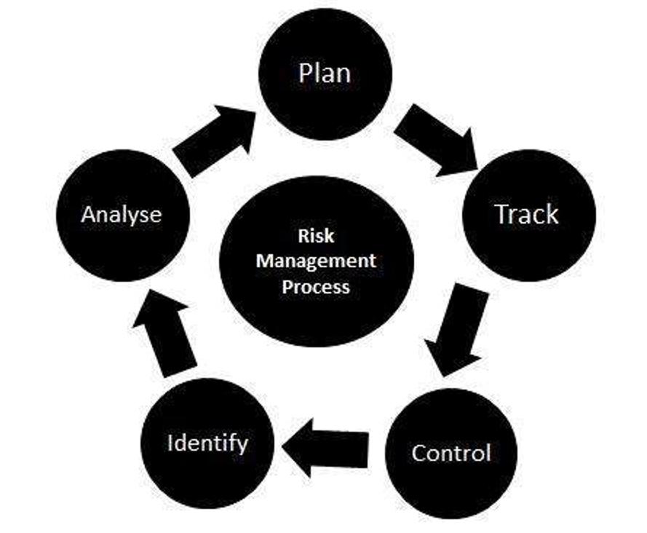
RISKS
Integrity level is 1 (negligible)
According to IEEE829 mitigation in this level of integrity is not required but for this project is going to be used since it’s the first project for this team. Risk – Wrong time estimation to complete testing or the whole project.
Mitigation plan – Establish the scope before beginning the testing tasks and pay attention in the project planning and also track the time estimates constantly.
Risk – Improper training or lack of knowledge of team members.
Mitigation plan – Team lead or manager has to make sure that a team member has required knowledge to complete the task before assigning it. If the task can not be assigned to a different team member make sure that this team member gets proper training from the rest of the team, manager or from ITExperts staff.
Risk – Product is too complex to test.
Mitigation plan – Carefully prepare a test plan. Develop and execute manual testing first. If during designing, developing or executing automation 30% of test can be implemented then the scope of the test plan may be changed

Slide 18
Test Processes
TEST PLANING
TEST MONITORING AND CONTROL
TEST ANALYSIS (what to test)
TEST DESIGN (how to test)
TEST IMPLEMENTATION (do we have everything to run tests)
TEST EXECUTION
TEST COMPLETION

Slide 19
The stakeholders
Dealers;
Private Sellers;
Customers;
Employees;
Third Party;
Owners;

Slide 20
Roles and responsibilities
Role | Minimum Resources Recommended (number of workers allocated full-time) | Responsibilities/Comments
QA Lead | 1 | Prepare Test Plan
QA Manager | 1 | Provides management oversight Responsibilities: Provide technical direction Acquire appropriate resources Management reporting
QA Engineer | 2 | Execute testing process Responsibilities: Write Test Cases Execute Test Cases manually Execute Test Cases using automation tools Write Bug Reports

Slide 21
PROJECT milestoneS
Task | Volume of work | Starting Date | Expiration Date
Test Plan Creation | 4 days | 01.15.2019 | 01.19.2019
SetUp Enviroment | 2 days | 01.19.2019 | 01.22.2019
Writing Test Cases | 7 days | 01.23.2019 | 02.01.2019
Automation test Execution | 7 days | 02.04.2019 | 02.13.2019
Analysis of Testing | 3 days | 02.14.2019 | 02.18.2019
Presentation Date |  |  | 02.19.2019

Slide 22
During the Automation Testing process the following application functions will be tested:
Search for used cars
Search for new cars
Search for pre-certified cars
Different types of the decision making tools like car values, questions.

Slide 23
The table sets of hardware and software resources for the testing Website:
Mac OS WINDOWS
BROWSER
GOOGLE CHROME,
Firefox;
Safari

Slide 24
Methods, approaching validate the data
The identification of functions that the software is expected to perform
The creation of input data based on the function's specifications
The determination of output based on the function's specifications
The execution of the test case
The comparison of actual and expected outputs
To check whether the application works as per the customer need

Slide 25
IN Automation testing process
- TECHNOLOGIES WERE USED:
JAVA
JUNIT
MAVEN
SELENIUM WEB-DRIVER
KATALON IDE
JENKINS
INTELLIJ
NETBEANS
GIT
GITHUB
DATA DRIVEN TESTING

Slide 26
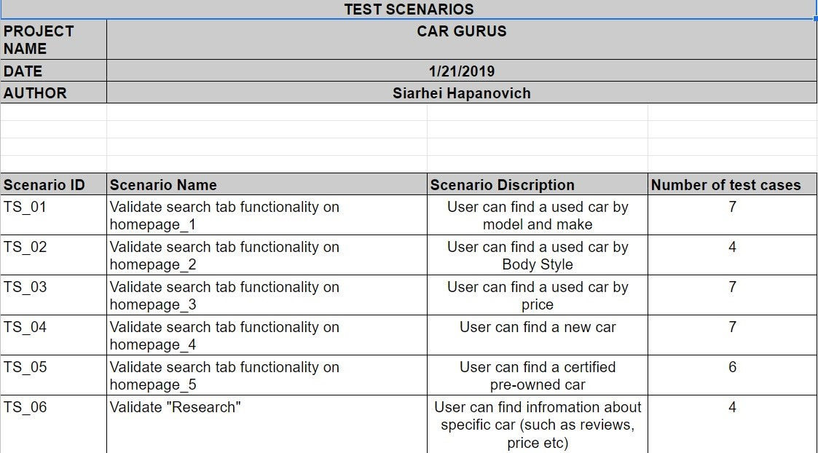
MANUAL TESTING #1

Slide 27
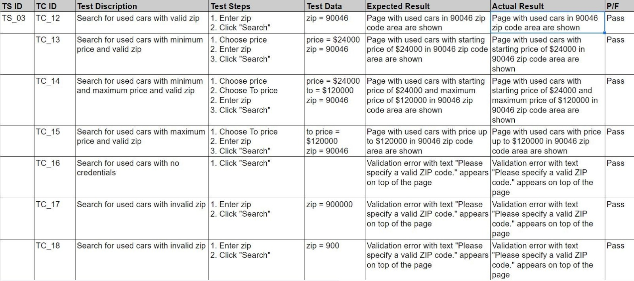
MANUAL TESTING #2

Slide 28
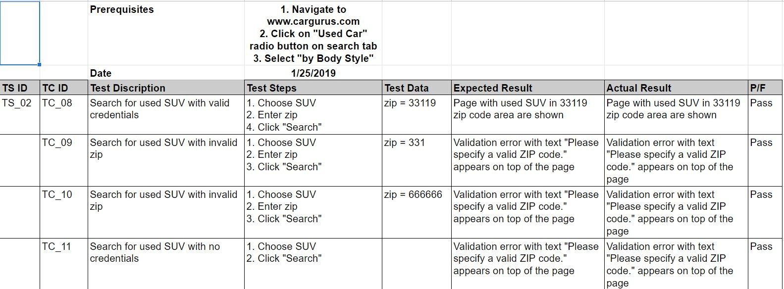
MANUAL TESTING #3

Slide 29
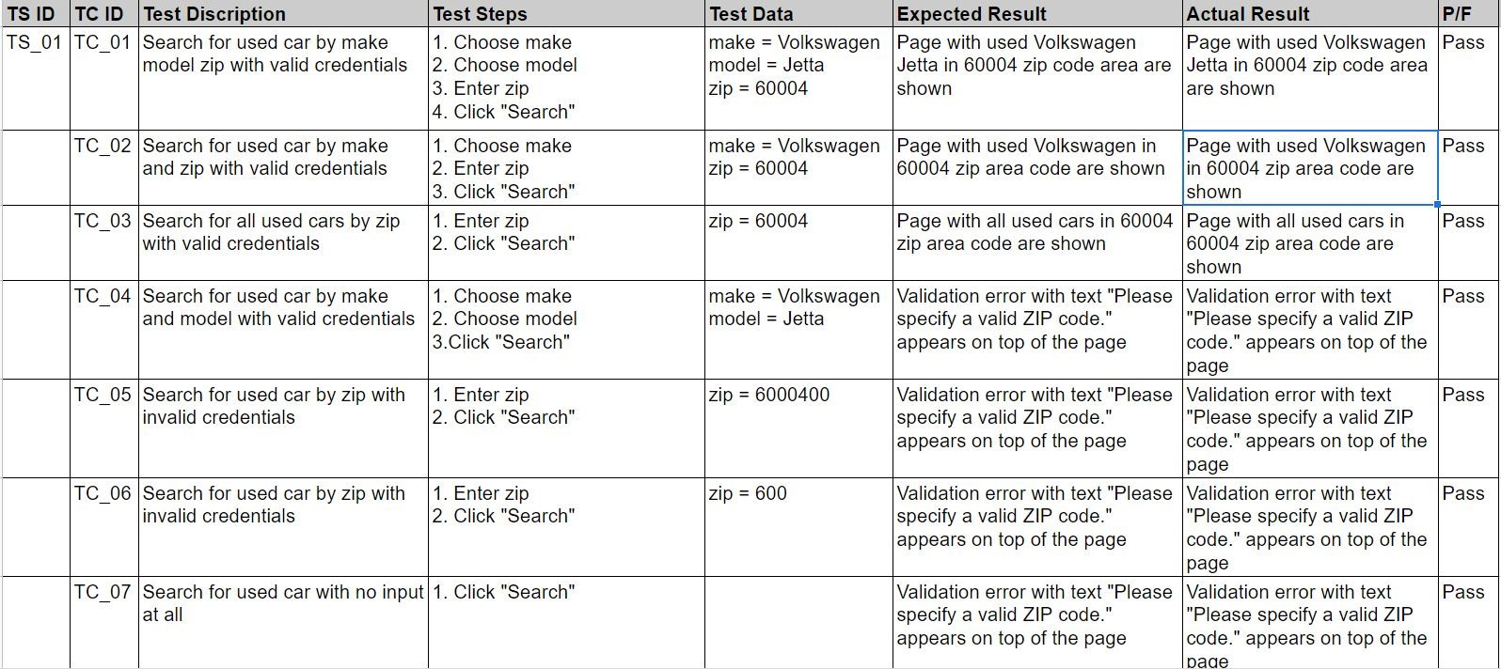
MANUAL TESTING #4

Slide 30
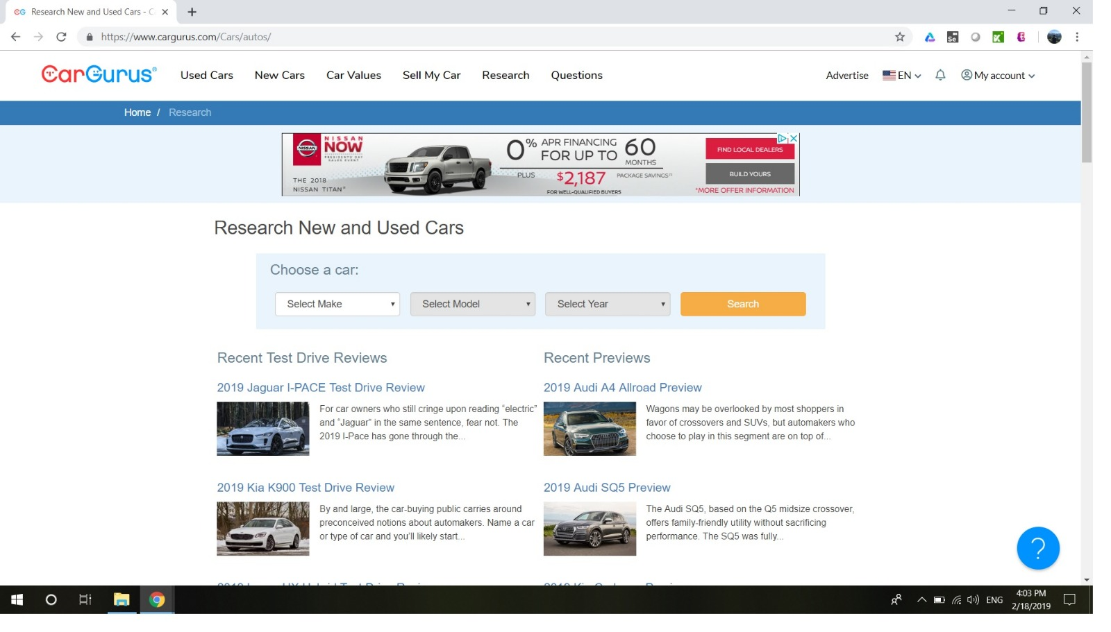
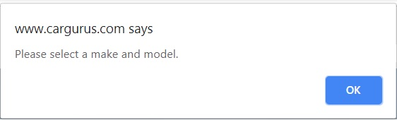
FAILURE WAS FOUND

Slide 31
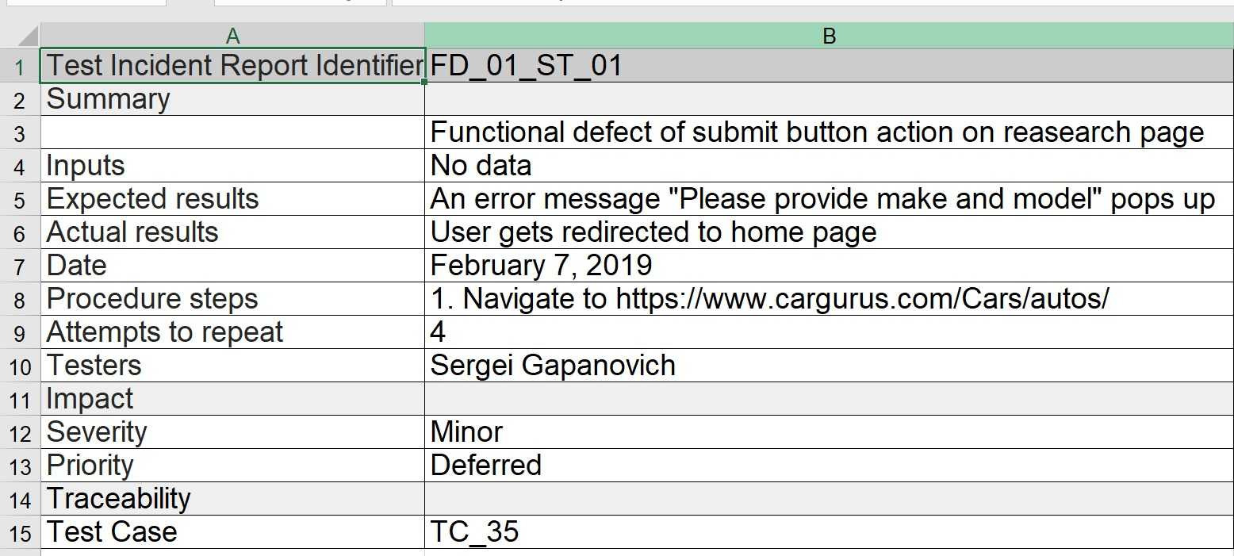
INCIDENT REPORT

Slide 32


NetBeans is an integrated development environment (IDE) for Java. NetBeans allows applications to be developed from a set of modular software components called modules

Slide 33

Katalon ide
Katalon Recorder helps record, play, debug, manage automated tests, and export to C#, Java, Ruby, Python, Groovy, or Robot Framework

Slide 34
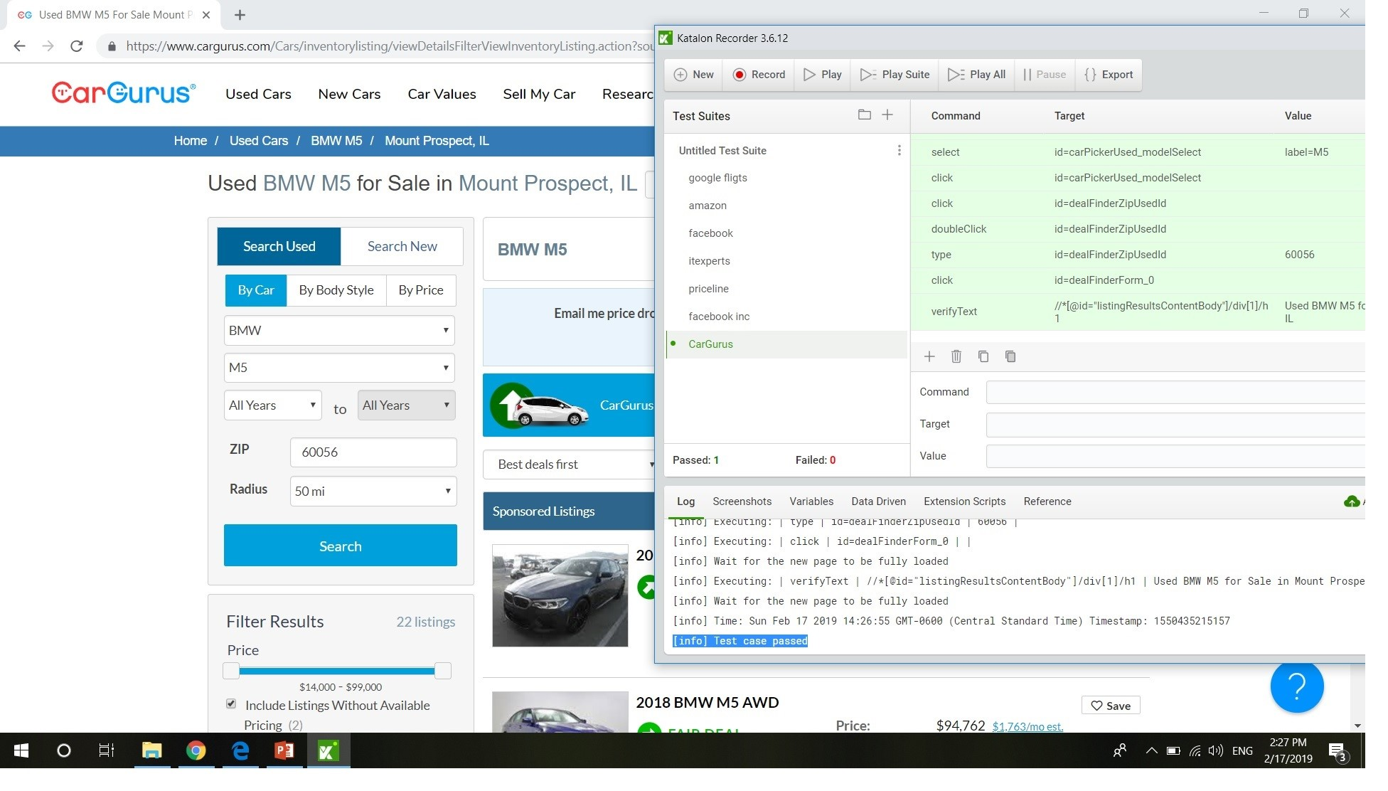
KATALON IDE RECORD AND PLAY

Slide 35
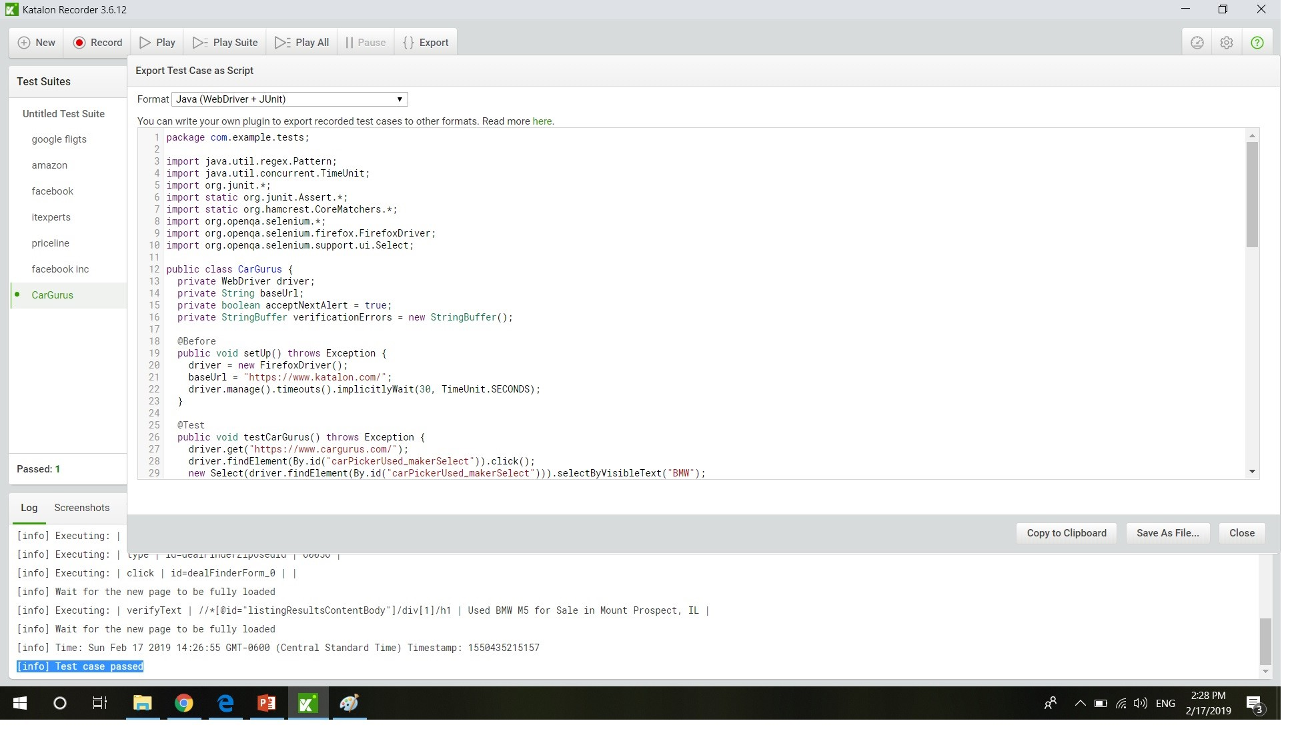
KATALON IDE EXPORT

Slide 36

INTELLIJ IDEA
IntelliJ IDEA
is a Java integrated development environment (IDE)
for developing computer software.

Slide 37

Selenium webdriver
Selenium-WebDriver makes direct calls to the browser using each browser’s native support for automation. How these direct calls are made, and the features they support depends on the browser you are using.

Slide 38

Dependency management
Build lifecycle management
Large existing repository
Build process is standardized for all projects
Easy to plugin to CI, You can run the same build locally and via a ci tool like Jenkins by setting up a maven build job

Slide 39
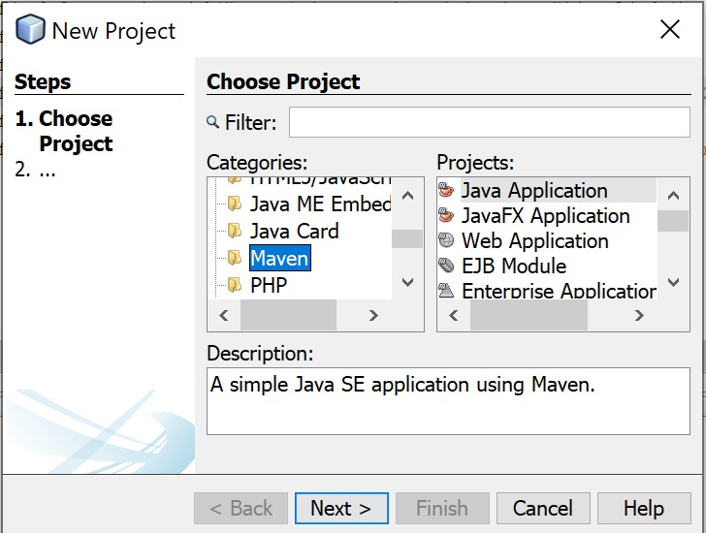
CREATION OF MAVEN PROJECT

Slide 40
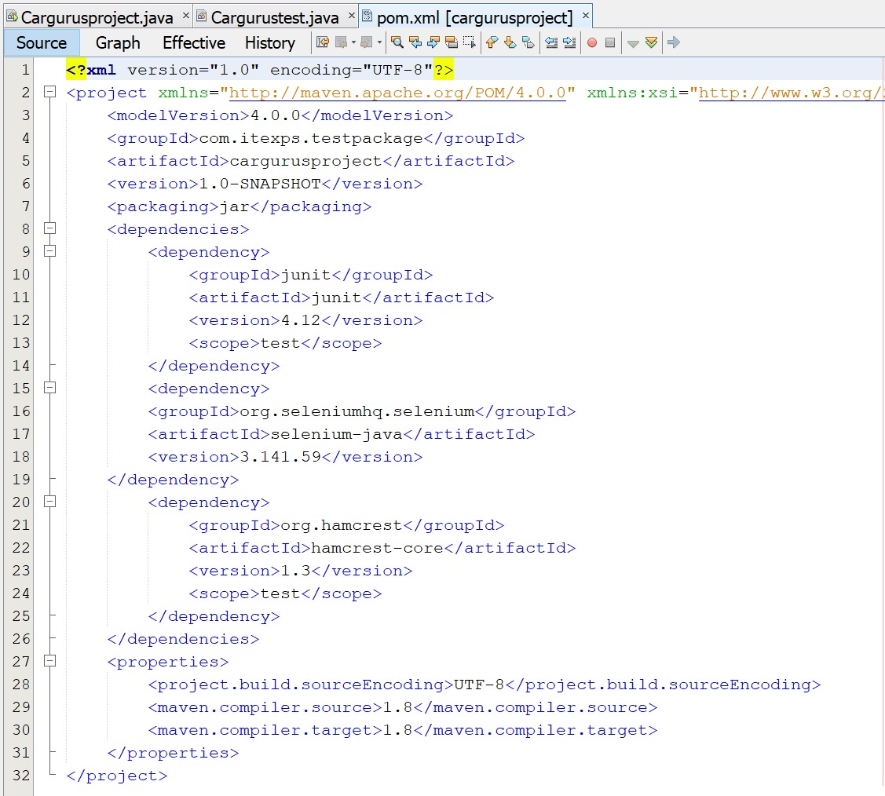
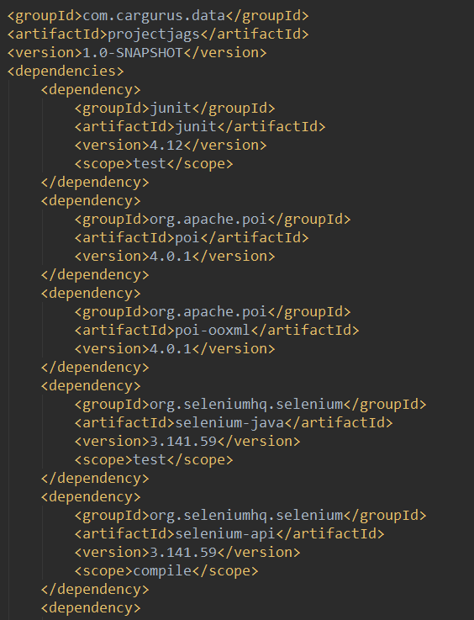
POM File screenshot

Slide 41

J-Unit is an open source framework designed for the purpose of writing and running tests. J-unit Provides:
Annotations to identify test methods assertions for testing expected results test runners for running test
Allows you to writes code fasten
Increases QUALITY
Simple
Less time
Tests can be run automatically
Test suites
Test progress

Slide 42
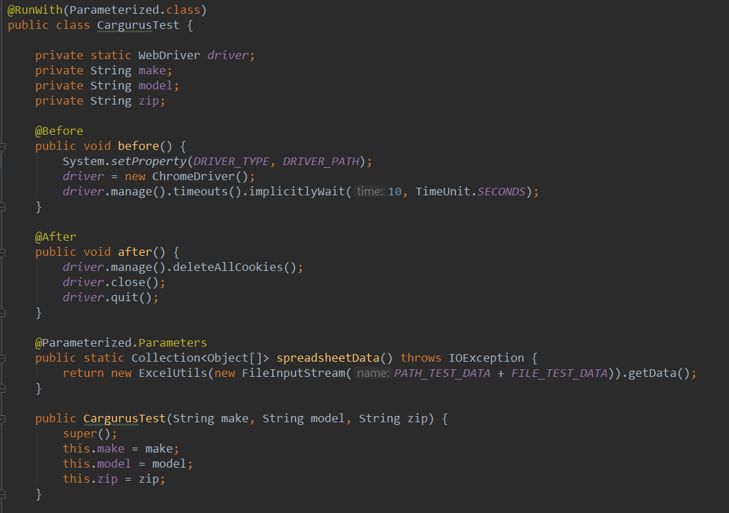
J-Unit is an open source framework designed for the purpose of writing and running tests.

Slide 43
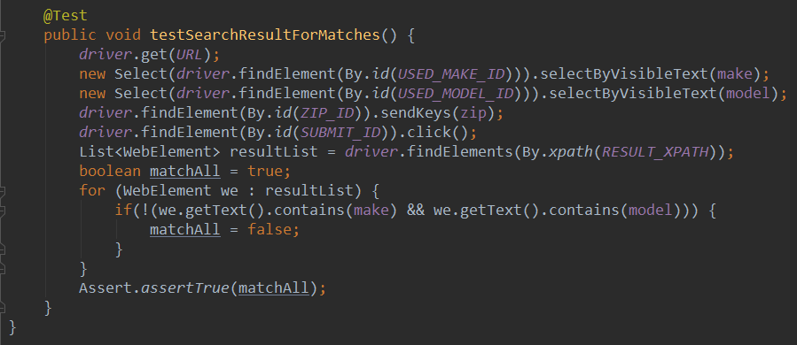
J-Unit is an open source framework designed for the purpose of writing and running tests.

Slide 44

Git is a free and open source distributed version control system designed to handle everything from small to very large projects with speed and efficiency.

Slide 45

GitHub is a web-based version-control and collaboration platform for software developers. Git is used to store the source code for a project and track the complete history of all changes to that code. It allows developers to collaborate on a project more effectively by providing tools for managing possibly conflicting changes from multiple developers.

Slide 46

Jenkins is an open source automation server written in Java. Jenkins helps to automate the non-human part of the software development process, with continuous integration and facilitating technical aspects of continuous delivery.

Slide 47
Data driver testing
Data-driven testing (DDT) is a software testing methodology that is used in the testing of computer software to describe testing done using a table of conditions directly as test inputs and verifiable outputs as well as the process where test environment settings and control are not hard-coded. In the simplest form the tester supplies the inputs from a row in the table and expects the outputs which occur in the same row.

Slide 48
CONCLUSION
CHALLENGES

Slide 49
The project was created and presented by the group of ITEXPS students:
SERGEY HAPANOVICH
ALEX BALBUS
GRIGOR NIKOLOV
JURGITA NARVILIENE
With the support, professional help and guidance by
Narendra Lilaramani & Tushar Patel © ITEXPS_Students, 2019

